Slide 1
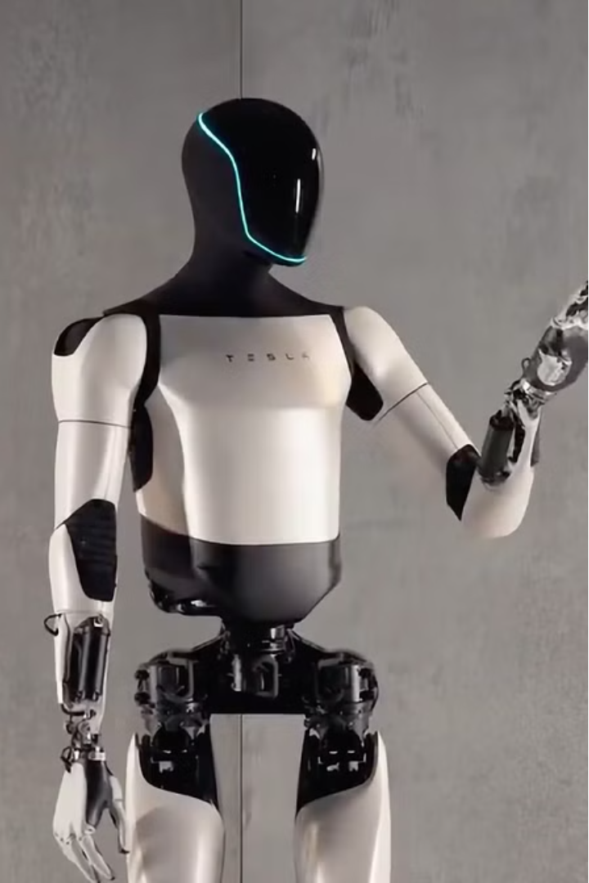
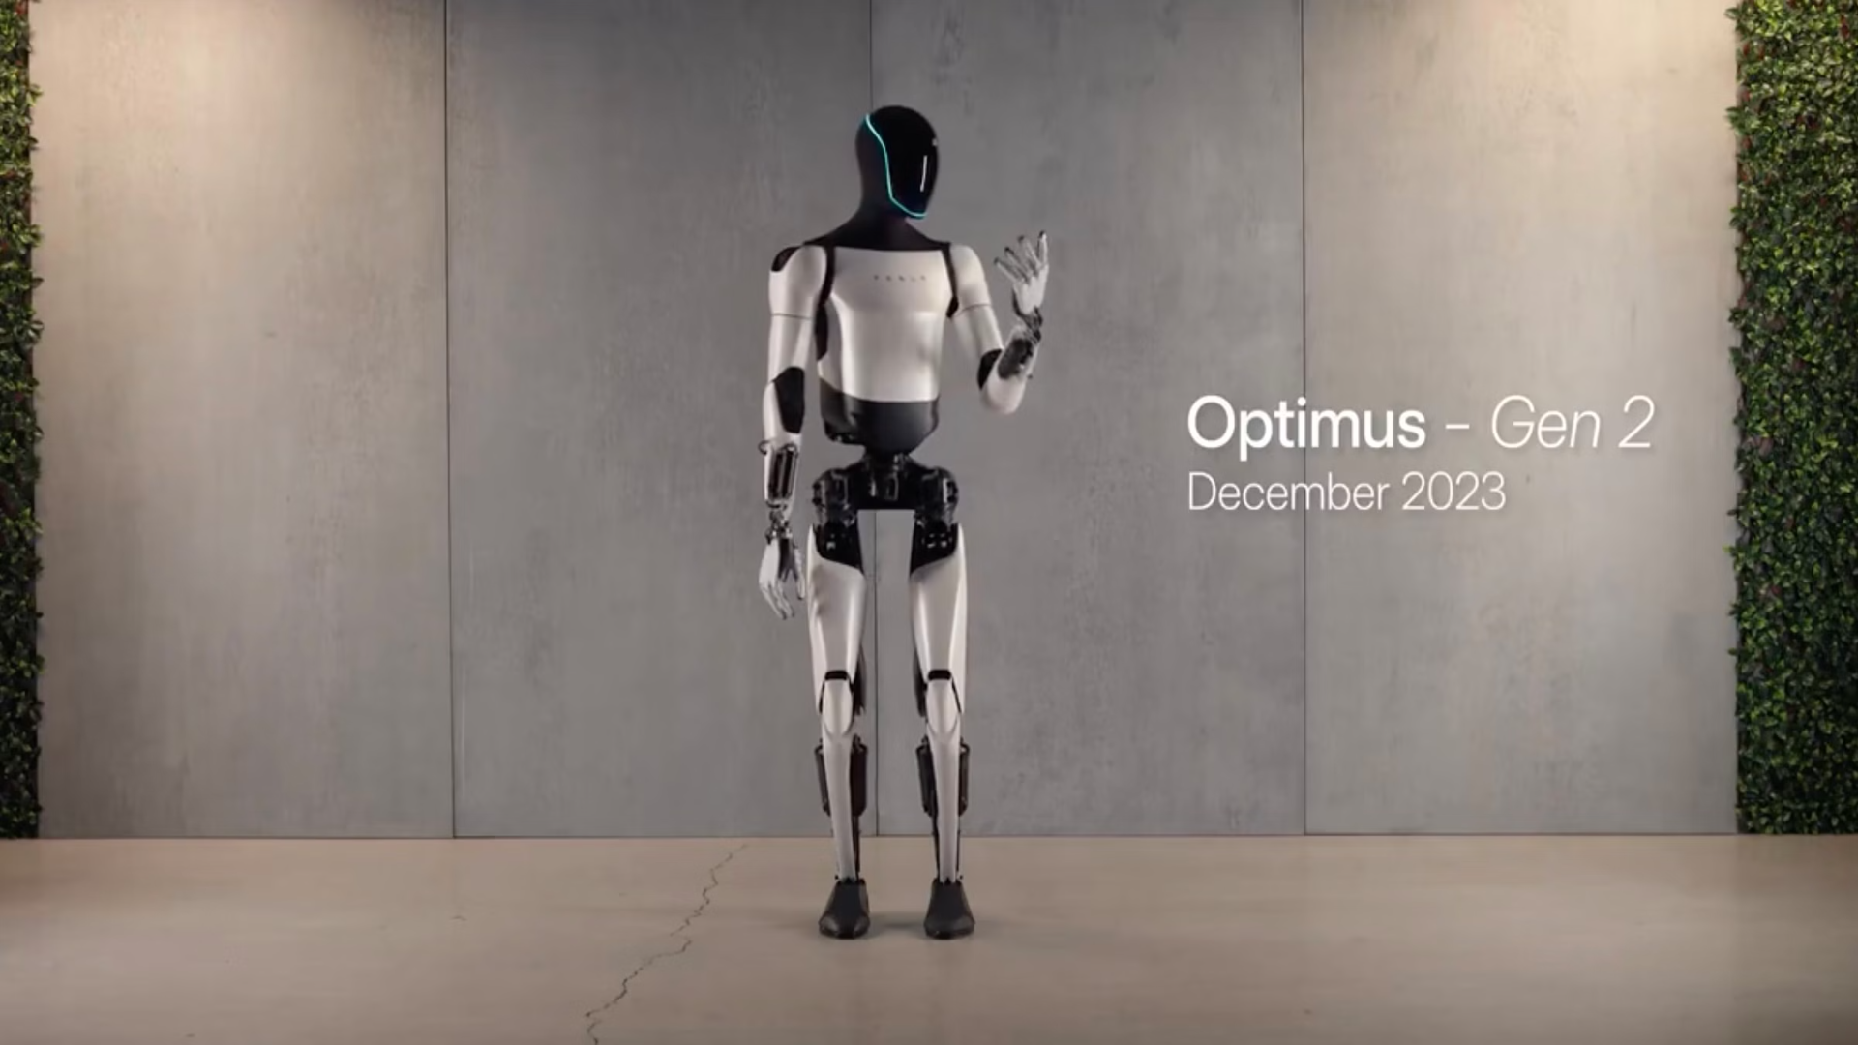
Optimus Gen 2: The Next Generation
Introducing the highly anticipated Optimus Gen 2, the latest advancement in cutting-edge robotics technology. Crafted with precision engineering and a bold, streamlined aesthetic, this next-generation platform sets a new standard for performance, efficiency, and adaptability. Prepare to be captivated by its seamless integration of state-of-the-art hardware and intelligent software, poised to redefine the future of automation and revolutionize the way we interact with intelligent machines.

Slide 2
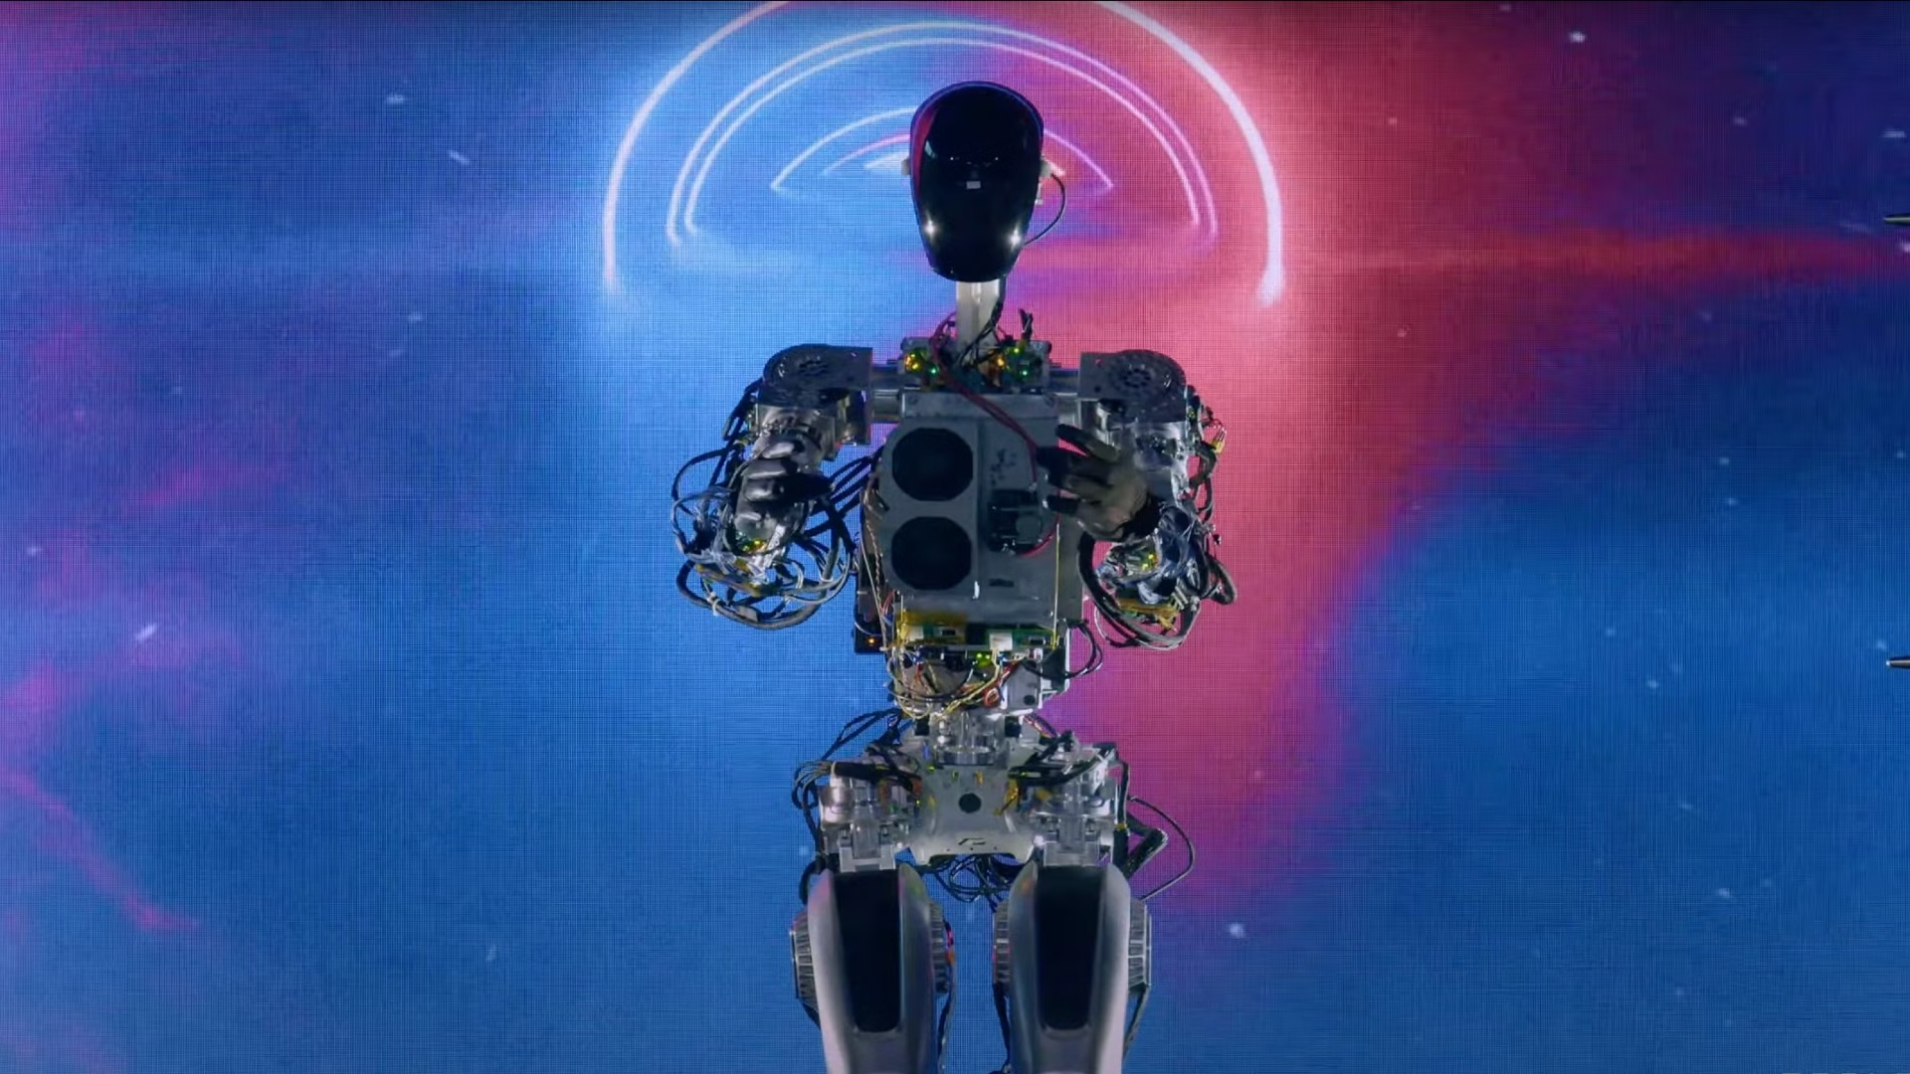
Key Features
Enhanced Mobility
Improved Sensory Perception
Intelligent Decision-Making
The Optimus Gen 2 boasts a refined, lightweight frame that enhances its agility and maneuverability, allowing it to navigate complex environments with unparalleled precision and speed. Its advanced actuators and carefully calibrated balance systems enable smooth, fluid movements, making it a versatile platform for a wide range of applications.
Packed with a suite of cutting-edge sensors, the Optimus Gen 2 is equipped with heightened situational awareness, empowering it to perceive its surroundings with remarkable clarity. From high-resolution cameras and sensitive tactile feedback to advanced object recognition and spatial mapping, this robot is designed to navigate complex environments with unparalleled responsiveness and understanding.
Powered by a sophisticated artificial intelligence system, the Optimus Gen 2 demonstrates advanced problem-solving capabilities, enabling it to make informed decisions and adapt to changing conditions in real-time. Its deep learning algorithms and data-driven reasoning allow for seamless integration with a variety of tasks, making it a valuable asset in both industrial and collaborative settings.

Slide 3
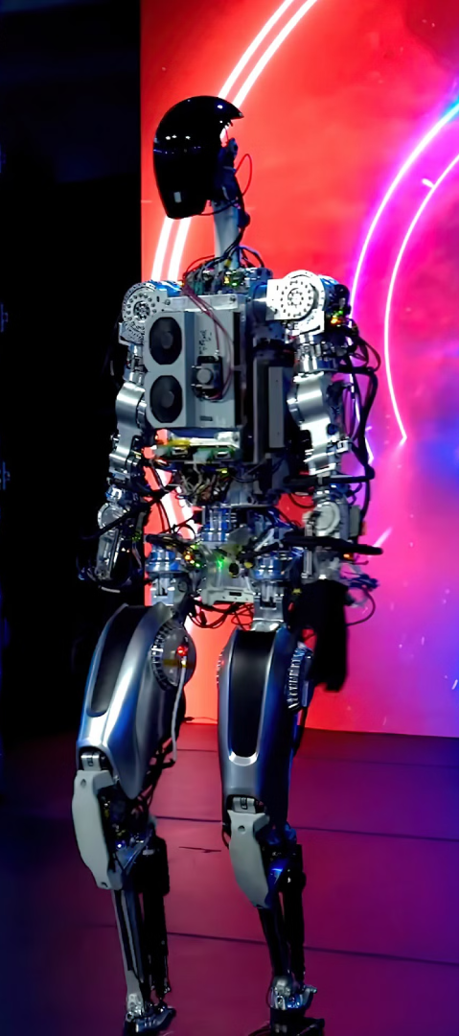
Improved Performance and Efficiency
1
Enhanced Power Management
The Optimus Gen 2 features a cutting-edge power management system that optimizes energy consumption, allowing for extended runtime and increased operational efficiency. Its advanced battery technology and intelligent power regulation algorithms ensure reliable, sustainable performance, even in demanding applications.
2
Adaptive Control Systems
At the heart of the Optimus Gen 2 lies a sophisticated control system that adapts to diverse environments and tasks. This adaptive architecture enables the robot to dynamically adjust its behavior, resource allocation, and decision-making processes, ensuring optimal performance and efficiency in a wide range of scenarios.
3
Streamlined Design
The Optimus Gen 2's sleek and aerodynamic design not only enhances its visual appeal but also contributes to its overall efficiency. By minimizing drag and optimizing weight distribution, the robot's movements are more fluid and energy-efficient, making it an ideal choice for applications where performance and sustainability are paramount.

